Slide 1
Cyclistic Bike-Share Ride Length by Customer Type

Slide 2
Purpose
In order to better assist with the upcoming marketing program, the task to analyze how annual members and casual riders use Cyclistic bikes differently was assigned.
The following presentation will present those findings as well as any observations that could serve to help convert casual riders to annual members.

Slide 3
Data Source
The data used in the analysis was directly sourced from Cyclistic analytics, which was collected at the beginning and end of rides, and recorded various metrics, including ride length, date and time, and rider type. The period of time used was Q1 2019 data, as well as Q1 2020 data.

Slide 4
Data Cleaning and Manipulation
The Q1 2019 and Q1 2020 datasets were both manipulated in the following ways:
Ride length was calculated by subtracting start time from end time and formatted for HH:MM:SS
Day of the week was added for each entry by using existing data provided.
Some basic calculations of average ride length, by customer type and day of the week, as well as the total count of rides by customer type and day of the week.
After this both datasets were combined using R, and further manipulation of data and cleaning occurred.

Slide 5
Data Cleaning and Manipulation
In R, 2019 column names were changed to match the column names in the 2020 dataset
Customer type terminology was to “member” & “casual” from “Subscriber” & “Customer” respectively
Convert “day_of_week” from a numeric ordering to the week names for clarity and ease of use
Aggregate individual ride length to average ride length by customer type and day of the week
Remove unnecessary columns from dataset, leaving only member_casual, day_of_week, and ride_length(average)
This dataset was then converted to .csv file for additional use

Slide 6
Analysis Summary & Graphical analysis

Slide 7
Analysis
In the following charts we see that casual riders far outnumber members every day of the week in average ride length and sheer quantity of rides.
Looking deeper we see that Thursday has the longest average ride times for casual riders, and Saturday & Sunday have the longest average ride times for members.
Looking at percentages of average ride length by customer type and day of the week, we find that members make up only about 13% of the total average ride length of all Cyclistic riders for this time frame.
We are also able to better visualize the daily proportion of member to casual riders average ride length by examining the pie charts grouped by day of the week.

Slide 8
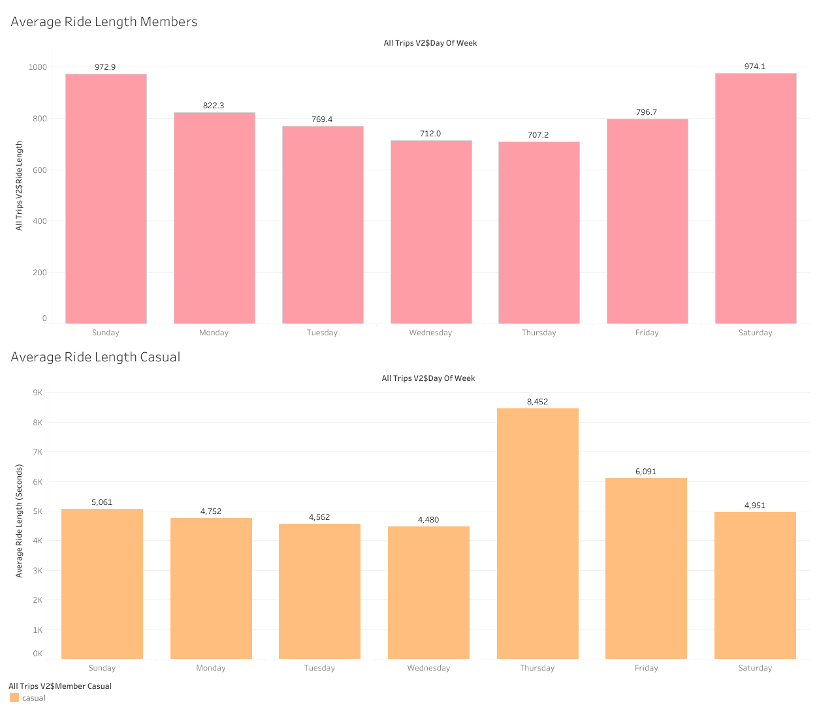

Slide 9
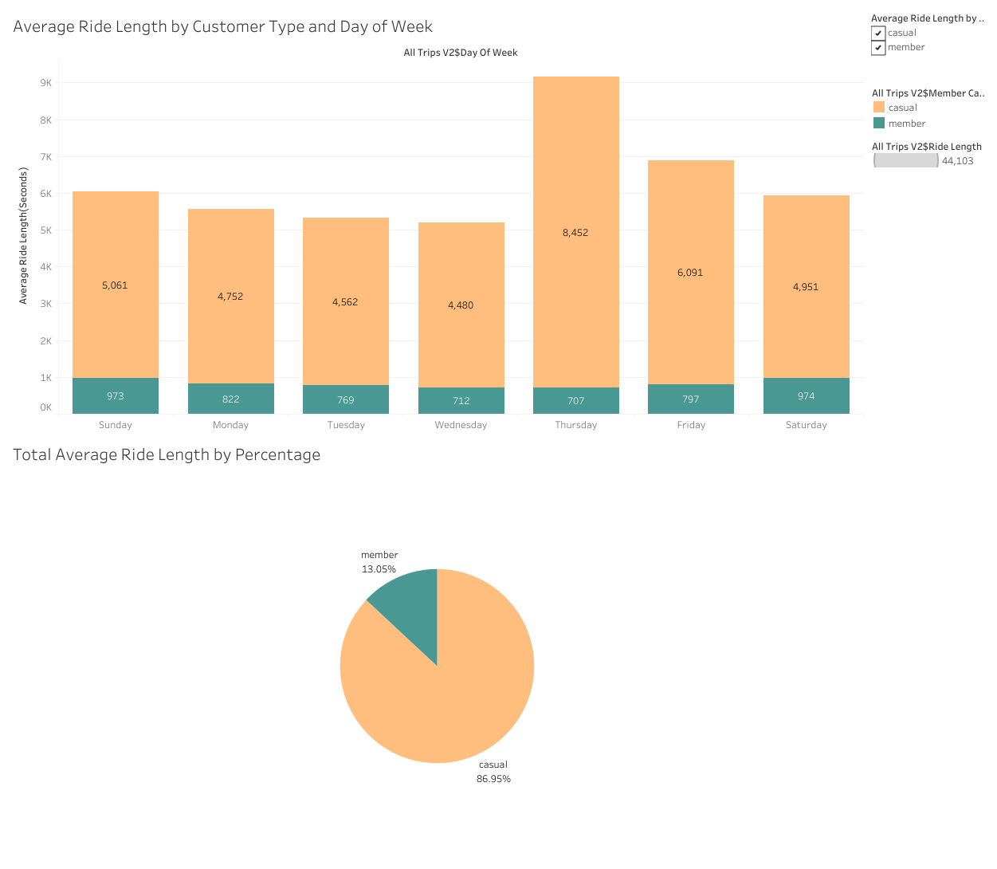

Slide 10
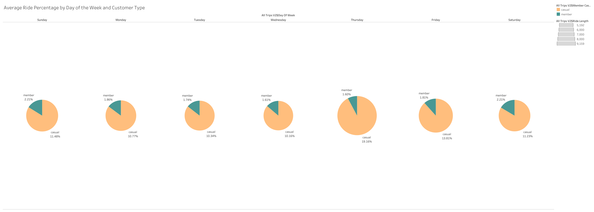

Slide 11
2019 Q1
Percentage of Casual Riders: 6.34%
2020 Q1
Percentage of Casual Riders: 11.35%

Slide 12
Recommendations
Target casual riders who typically use Cyclistic on Thursday, the biggest day for rides by average ride length.
Use data collected over a prolonged time to see if casual riders are regular customers, and if possible ascertain if they use Cyclistic for commuting to work or other essential functions of daily life.
Conduct a survey targeted at casual members about why and when they choose to use Cyclistic, and what features if any would incentivize them to become members

Slide 13
Conclusion
In conclusion, I believe the analysis of the data provided shows a clear trend that Cyclistic bikes are used on average, for longer, and by more casual riders than riders with memberships.
I believe more data on the regularity of casual customers as well as a potential survey targeting these types of customers and what they would like from a membership would be important to further the development of a coherent and effective marketing campaign, targeted at increasing membership rates among Cyclistic rider.

Slide 14
Thank you
Evan Lee
Data Analyst

